Slide 1

HMMG Meeting Highlights
Status
Almost all project models in or on the way into the HM
Good cooperation with most PTs
Cooperation with OGC and Sparx
Integration of models
Exchange of experiences
Follow up with Sparx on some suggested improvements
HMMG Attendance
Project leaders, editors and WG convenors must register as HMMG Members and are expected to attend the HMMG meeting
EA is mandatory for all UML work!
Use a recent version (15 or 16)
ShapeChange supports both versions
Sparx Systems provides free licenses for development and maintenance of the Harmonised Model
Experts, Project leaders, Editors, Convenors…
Requests are handled through the ISO/TC 211 Secretariat

Slide 2



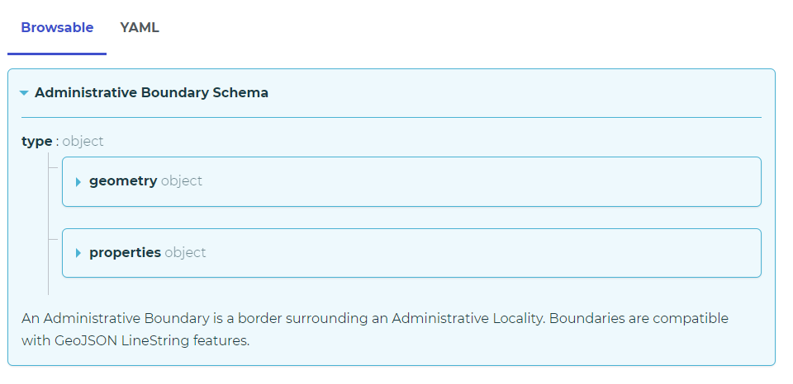
HMMG Meeting Highlights
Overture Maps
Big companies, open data – will be important for the future
Open schemas in YAML
HMMG working on scripts for mapping to ISO/TC 211 UML
Unique identifiers
Linear referencing
ISO/TC 211 need to:
Observe the development
Consider the consequences

